Slide 1
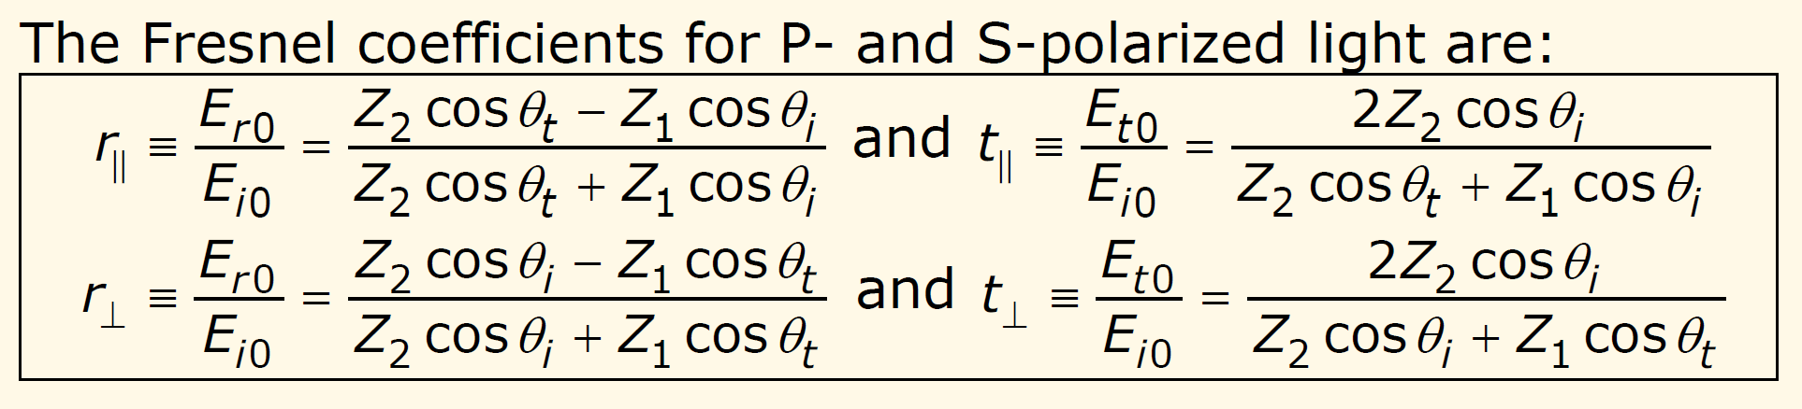
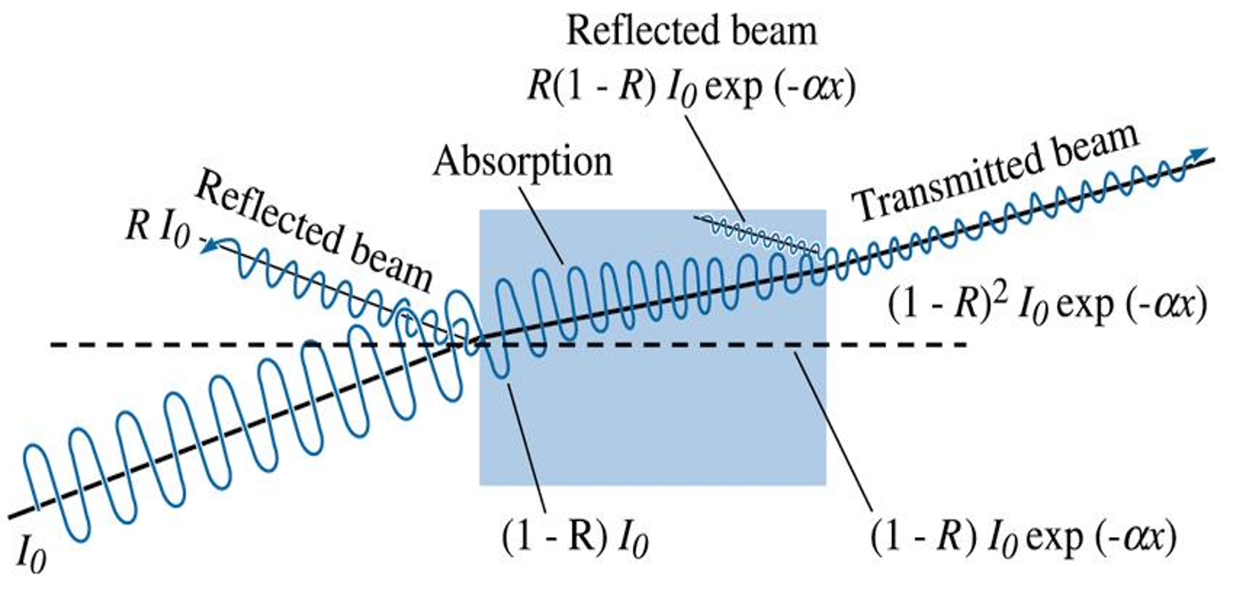
Chapter 5
PH22006:

Slide 2
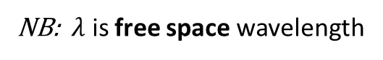
Optical Coefficients
Chapter 5
Complex refractive index
n is the refractive index and determines the phase velocity, c/n.
n>0 in naturally occurring materials
κ (Greek letter kappa) is the extinction coefficient and determines the absorption.
NB: $λ$ is free space wavelength

Slide 3
Chapter 5
Complex dielectric constant and susceptibility
The frequency-dependent complex dielectric constant
(also called relative permittivity) is directly related to the electronic and vibrational energy band structure of solids.
The material physics is contained in the polarization, P (dipole moment per unit volume) induced by an applied electric field.
For an isotropic material
where
The electric susceptibility is defined by

Slide 4
Chapter 5
It is useful to be able to convert between (the quantity usually derived theoretically) and (usually measured experimentally) and vice-versa:
From the above we can get the quadratic equations for n² and with
solutions

Slide 5
Chapter 5
Weakly absorbing materials
ε₁ >> ε₂
and to a first approx.
More exactly,
(using Binomial approximation)

Slide 6
Chapter 5
Strongly absorbing materials
ε₂ >> ε₁

Slide 7
Chapter 5
Fresnel coefficients at normal incidence

Slide 8
Relative permeability
Chapter 5
The complex relative permeability ( ) in naturally occurring materials is generally taken as close to 1 at high frequency.
This is because the magnetization induced by an H field cannot change quickly enough to follow the field at optical frequencies. At low frequency (< 100 GHz) in magnetic materials can however be many thousands.
There are exceptions, particularly a class of artificial metal-dielectric composite materials that are structured on a sub-wavelength length scale and known as metamaterials (see lecture 11) and superconductors (for which ).

Slide 9
Lorentz oscillator model
Chapter 6
Describes propagation of light in insulators by assuming that matter can be treated as a collection of atomic, molecular and vibrational oscillators.
.
Atomic oscillator
The electrons and the nucleus form a dipole. During oscillations, the nucleus remains nearly stationary due to its heavy mass. We start by assuming that only a single bound electron oscillates.
If the electron has mass m_{o} and the spring constant is K_{s} the natural frequency is
Typical frequencies 10¹⁵-10¹⁶ Hz (visible – UV)
If optically anisotropic
then : K_{s} depends on
direction

Slide 10
Chapter 6
Atomic Oscillator Properties
The atomic oscillation produces a time varying dipole moment in addition to any pre-existing static atomic dipole moment.
Natural oscillations give rise to Hertzian dipole emission at
Forced oscillation at produces strong absorption
Forced oscillations at different to give weaker absorption
In dense matter re-radiation by optically driven dipole oscillators leads to constructive interference in forward direction and destructive interference in other directions (see lecture 10).
Dipole oscillations lag the applied driving optical field giving rise to delayed re-emission and reduced phase velocity for transmitted light (i.e. refractive index >1).

Slide 11
Chapter 6
Dielectric Constant in the Lorentz Model
The magnitude of the time varying dipole moment in the atomic oscillator model is given by
where x(t) is the displacement from the electron’s equilibrium position.
For one dipole, treated as a damped harmonic oscillator:
Equation of motion is:
Friction-like force
Optical driving force
Restoring force of ‘atomic spring’

Slide 12
Chapter 6
The time dependence of the driving optical electric field is
Hence look for solutions of form
Any phase differences between driving field and x is included by allowing
X_{o} to be complex.
Substituting into equation of motion we get
Solution for X_{o} is

Slide 13
Chapter 6
The polarization of a medium with N atoms per unit volume associated with the resonant oscillator response is then,
The electric displacement of the medium is
We can split the polarization into a non-resonant background term (due to different types of oscillator) and the resonant term just calculated for a single type of oscillator:

Slide 14
Chapter 6
where χ_{b} is the background (i.e. far from resonance of interest ) electric susceptibility.
Putting it all together we get
total susceptibility
Now extract the real and imaginary parts

Slide 15
Chapter 6
The low (static) and high frequency limits are:
and

Slide 16
Chapter 6
Notable features
There is clearly a resonance in ε₂ at ω=ω_{o} . It has a full width at half
maximum equal to γ (ε₂ is half max value when – see
Problem sheet 2).
Across a resonance region, there is a step change in ε₁ (and also n). Its size is determined by N and ω₀ and it affects a frequency range much wider than the absorption peak.
and n are higher on low frequency side of a resonance then on high frequency side.

Slide 17
Chapter 6
ε_{st}=12
ε∞=10
Note units

Slide 18
Chapter 6
4.3 Molecular oscillators
In a polar medium , the electron charge cloud
of some or all of the the bonds sits closer to one atom than the other. Ionic molecules are very polar. Purely covalent materials, in which identical atoms share electrons, are not polar.
M
Q
m
Q
Analysis is same as for atomic oscillator. will be lower because the oscillating mass (reduced mass µ is the relevant one) is larger than m_{o} by a factor ~ 10⁴ – 10⁵. Typically ~10¹²-10¹⁴ Hz (near infrared to far infrared).
Some gases and most organic compounds can be characterised by the frequencies of their infrared absorption peaks.
A polar molecule. The atoms are positively and negatively charged.
(see lecture 9 for more detail)

Slide 19
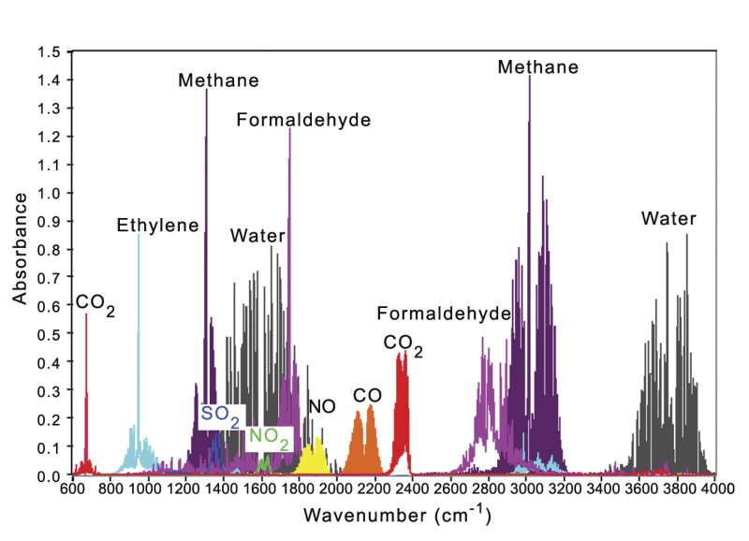
Chapter 6

Slide 20
Multiple resonances
Chapter 7
A real optical material will have many characteristic resonance frequencies (e.g. different electronic transitions, lattice vibrations). We can add these resonances into the Lorentz model.
which gives

Slide 21
Chapter 7
Hypothetical solid with three well separated resonances
At very high frequencies, the
electrons cannot respond to the field.
There is no polarization and n=1.
Highest frequency electronic
resonance is for inner electrons of atoms (x-ray region).
At a lower frequency (UV-visible):
electronic transitions of outer atomic electron shells are involved.
In the IR there are resonances at vibrational frequencies of a solid or molecular gas/liquid.

Slide 22
Chapter 7
Points to note
There is an absorption peak at each resonance and the refractive index “wiggles” across the resonance
Steps in refractive index are due to ε_{st} > ε∞ for each resonance. As previously defined, ε_{st} and ε∞ are relative to a single resonance – their values for a system of many resonances would be different.
Between the resonances, the medium is transparent - the absorption coefficient is very small and the refractive index is almost, but not completely, constant.

Slide 23
Chapter 7
In real materials, different resonances have different absorption coefficients. These can be measured experimentally.
The model can account for this by assigning a phenomenological oscillator strength, f_{j}, to each resonance.
We then have:
It can be shown from quantum mechanics that we must have
for any single electron.
We can understand this if a particular electron involved in several
transitions has its absorption ‘strength’ divided between the transitions.

Slide 24
Chapter 7
Experiment: pure silica glass
Example of multiple resonance response.
Strong absorption in the infrared
(two vibrational modes of SiO₂ molecule – no long range order so
that vibrations are localised).
Ultraviolet (electronic
transitions across bandgap of
10 eV).
Transparent at visible frequencies inside bandgap ( ).
Far infrared
X-ray

Slide 25
Chapter 7
Lorentz model and interband transitions
Lorentz oscillator model provides
a good description of transitions involving electrons localised on atoms or molecules, but
a poor description of interband transitions which involve delocalised electrons.
e.g. absorption spectrum of a gas consists of a series of
well defined defined peaks whereas interband absorption in a solid is
characterised by an absorption edge.
If resonant interband frequency is identified with E_{g} /h then n varies
qualitatively as expected around this frequency but does not – see data
for SiO₂ in section 5.1. Accurate description of interband transitions requires
quantum mechanical model.

Slide 26
Chapter 7
Dispersion
In the transparent region the refractive index increases with increasing frequency – this is called normal dispersion. In the highly absorbing regions n decreases with increasing frequency – this dispersion is described as anomalous.
Dispersion in the visible part of the spectrum arises from high frequency wing of infrared absorption and low frequency wing of UV absorption.
Note that n<1 at some frequencies and v_{ph}=c/n is > c. This does not violate relativity because signals travel at group velocity, which is > v_{ph}:

Slide 27
Chapter 7

